Slide 1
RAID
T28
38
05 de novembro de 2018

Slide 2
RAID Structure
RAID stands for redundant array of inexpensive (or independent) disks.
Set of physical disk drives viewed by the operating system as a single logical drive.
Data is distributed across the physical drives of an array for higher reliability and data-transfer rates.
Redundant disk capacity is used to store parity information and implement fault tolerance.
RAID functionality can be implemented a dedicated controller or even by the OS.
RAID offers good potential for incremental growth.

Slide 3
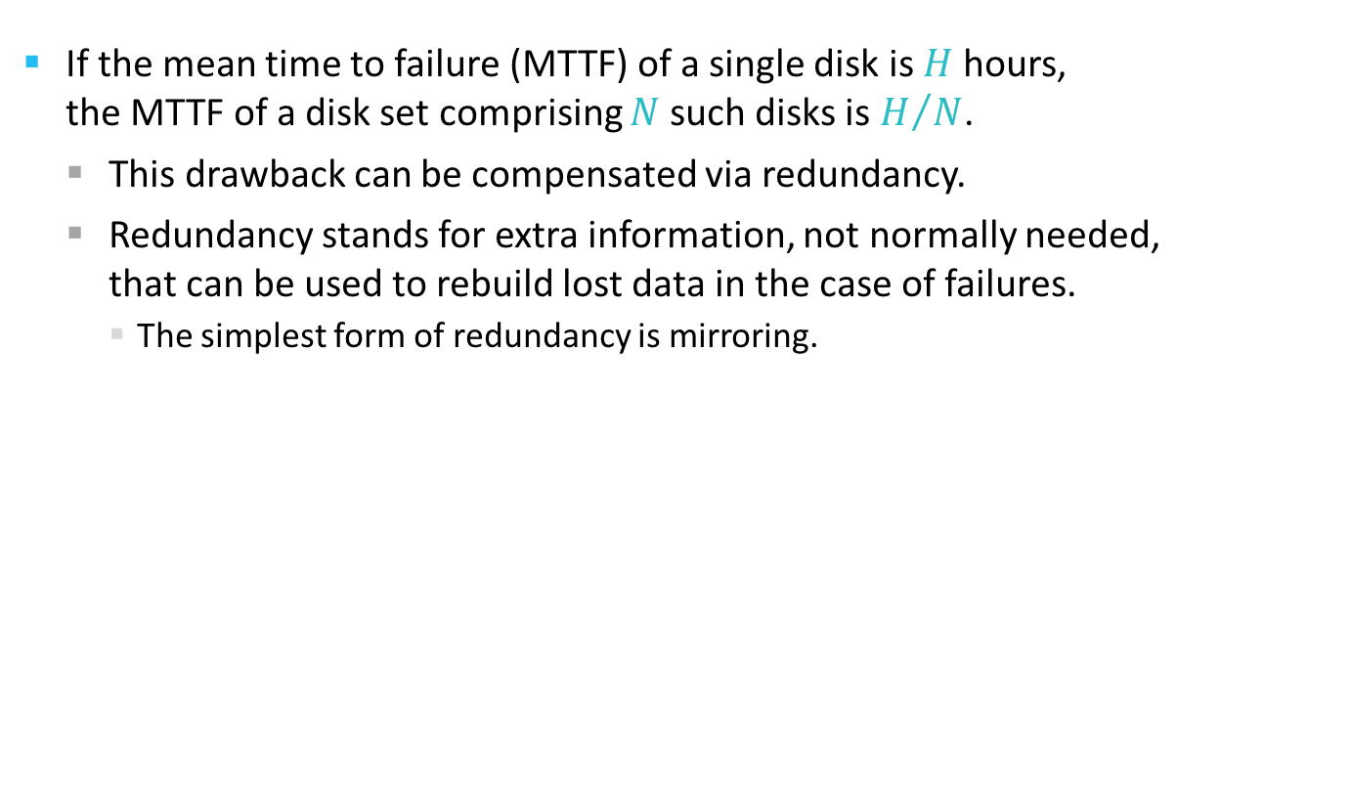
Reliability improvement via redundancy
If the mean time to failure (MTTF) of a single disk is $H$ hours, the MTTF of a disk set comprising $N$ such disks is $H/N$.
This drawback can be compensated via redundancy.
Redundancy stands for extra information, not normally needed, that can be used to rebuild lost data in the case of failures.
The simplest form of redundancy is mirroring.

Slide 4
Performance improvement via parallelism
There are two main goals for parallelism in a disk system
Increasing the throughput of multiple small accesses by load balancing.
Reducing the response time of large accesses.
Transfer rates for multiple disks can be improved by striping data across the disks.
Bit-level striping
Block-level striping

Slide 5
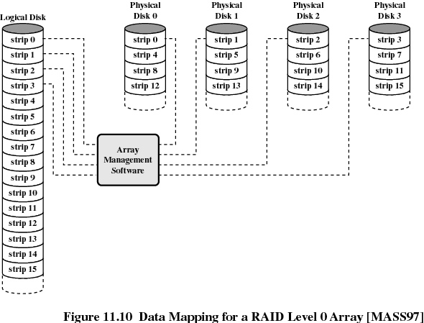
stripe
block
sector
track
…
strip =
Efficiency means high transfer rates.
Typical transfer involves data chunks comprising several strips

Slide 6
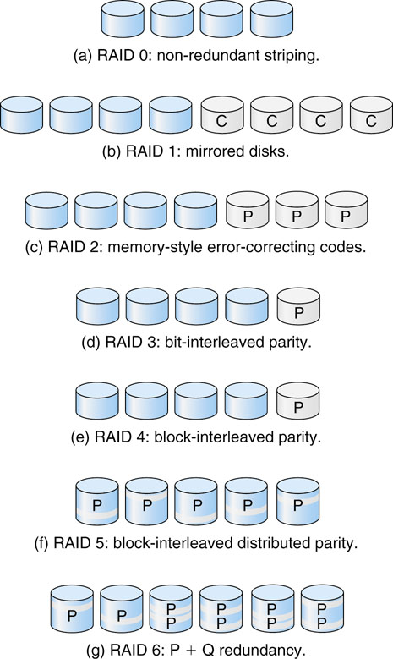
Typical Raid Levels

Slide 8
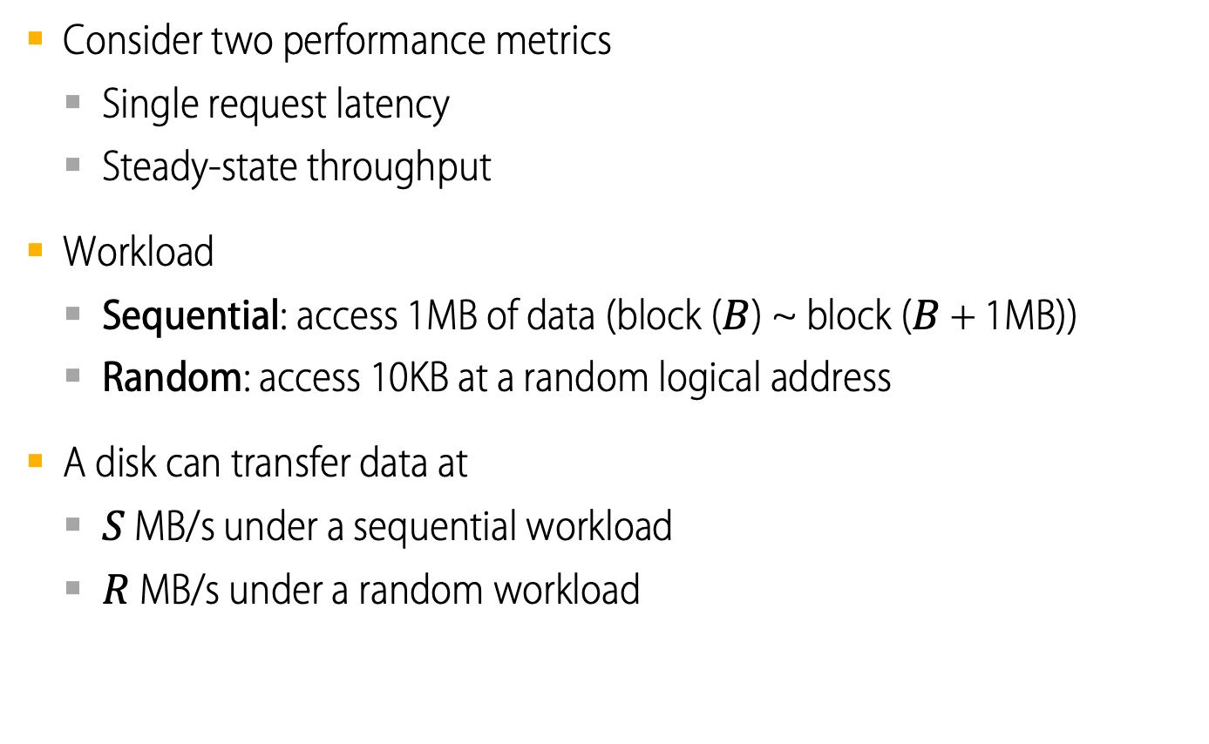
Evaluating RAID Performance
Consider two performance metrics
Single request latency
Steady-state throughput
Workload
Sequential: access 1MB of data (block ($B$) ~ block ($B$ + 1MB))
Random: access 10KB at a random logical address
A disk can transfer data at
$S$ MB/s under a sequential workload
$R$ MB/s under a random workload

Slide 9
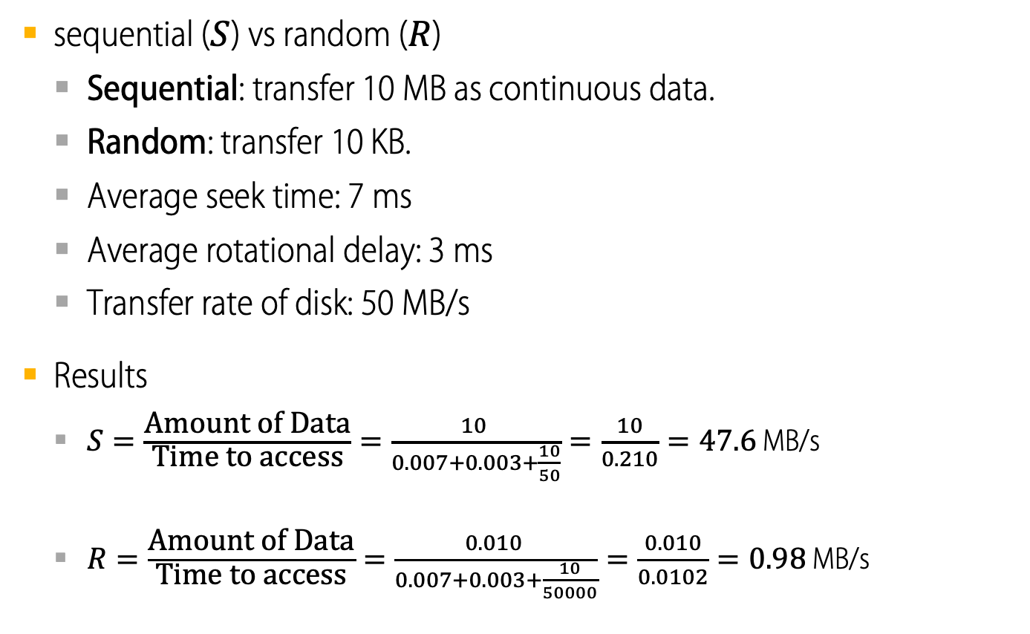
Example of RAID Performance Evaluation
sequential ($S$) vs random ($R$)
Sequential: transfer 10 MB as continuous data.
Random: transfer 10 KB.
Average seek time: 7 ms
Average rotational delay: 3 ms
Transfer rate of disk: 50 MB/s
Results
$S=\frac{\text{Amount} \text{of} \text{Data}}{\text{Time} \text{to} \text{access}}=\frac{10 }{0.007+0.003+\frac{10}{50}}=\frac{10}{0.210}=47.6$ MB/s
$R=\frac{\text{Amount} \text{of} \text{Data}}{\text{Time} \text{to} \text{access}}=\frac{0.010 }{0.007+0.003+\frac{10}{50000}}=\frac{0.010}{0.0102}=0.98$ MB/s

Slide 10
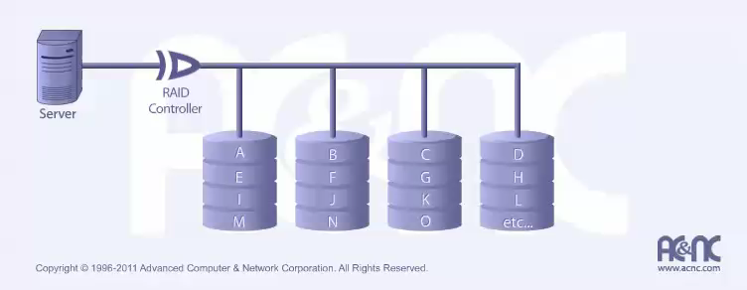
RAID 0 (striping)
A disk array with striping at the block level but without any redundancy.

Slide 11
RAID 0 (striping)
Characteristics & Advantages
Disadvantages
Improved I/O performance
Best when data is striped across multiple controllers with only one drive per controller
No parity calculation overhead
Very simple design
Easy to implement
Not a “true” RAID because there is NO redundancy or fault-tolerance
Failure of just one drive will result in all data in an array being lost
Should never be used in mission critical environments

Slide 12
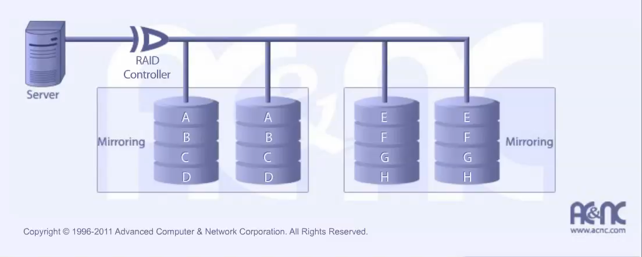
RAID 1 (mirroring)
A disk array with simple disk mirroring.

Slide 13
RAID 1 (mirroring)
Characteristics & Advantages
Disadvantages
One Write or two Reads possible per mirrored pair.
Twice Read and same Write transaction rate of single disk.
100% redundancy.
Same transfer rate per block of a single disk.
Can sustain multiple simultaneous drive failures.
Simplest RAID
Highest disk overhead of all RAIDs – inefficient
RAID function typically done by system software
Hardware implementation is strongly recommended
May not support hot swap of failed disk when implemented in “software”

Slide 14
RAID 2 (redundancy via Hamming code)
Each bit of data word is written to a data disk drive (4 in this example).
Each data word has its Hamming Code ECC word recorded on the ECC disks (3 in this example).
On Read, the ECC code verifies correct data or corrects single disk errors.

Slide 15
RAID 2 (redundancy via Hamming code)
Characteristics & Advantages
Disadvantages
“On the fly” data error correction
Extremely high data transfer rates possible
The larger the word size, the better the ratio of data disks to ECC disks
Relatively simple controller design compared to RAID levels 3, 4 & 5
Very high ratio of ECC disks to data disks with smaller word sizes – inefficient
Entry level cost very high thus requiring very high transfer rate need to justify
Transaction rate is equal to that of a single disk at best
No commercial implementations exist / not commercially viable

Slide 16
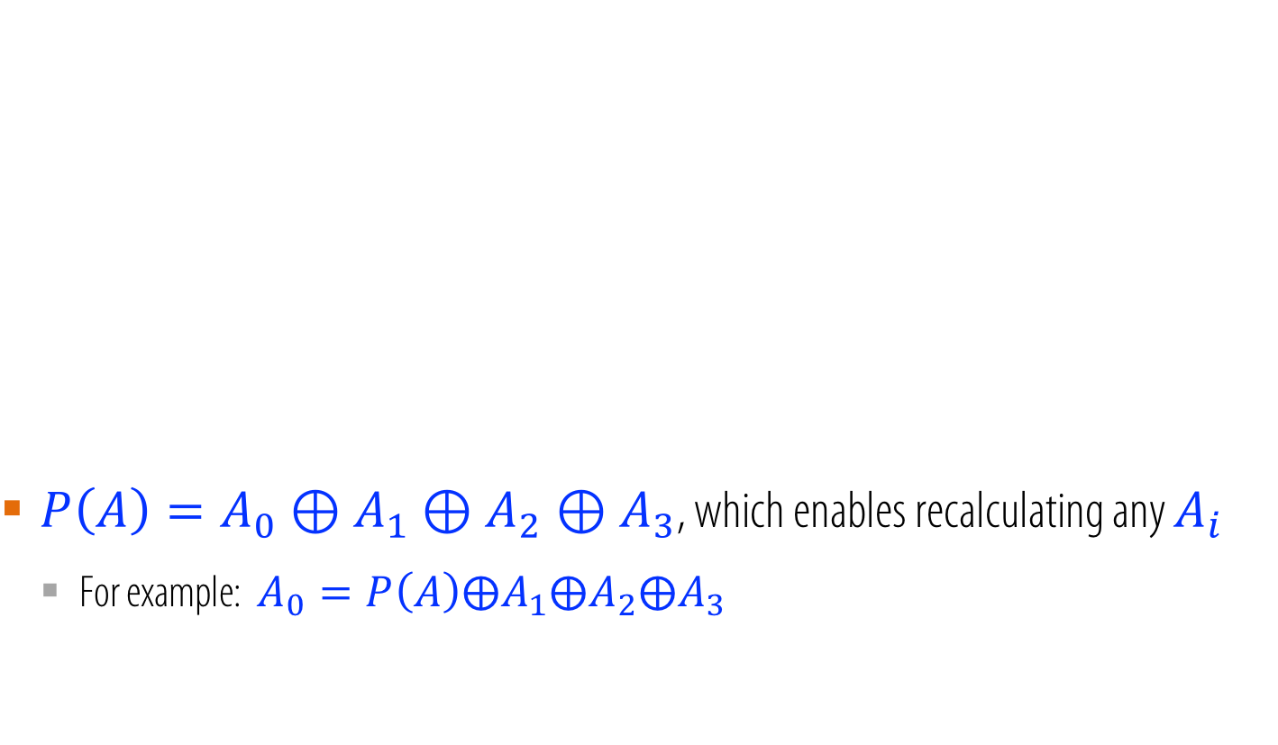
RAID 3 (bit-interleaved parity)
$P\left(A\right)=A_{0}⊕A_{1}⊕A_{2}⊕A_{3}$, which enables recalculating any $A_{i}$
For example: $A_{0}=P\left(A\right)⨁A_{1}⨁A_{2}⨁A_{3}$

Slide 17
RAID 3 (bit-interleaved parity)
Characteristics & Advantages
Disadvantages
Very high read data transfer rate
Very high write data transfer rate
Disk failure has an insignificant impact on throughput
Low ratio of ECC (Parity) disks to data disks means high efficiency
Transaction rate equal to that of a single disk drive at best (if spindles are synchronized)
Controller design is fairly complex
Very difficult and resource intensive to do as a “software” RAID

Slide 18
RAID 4 (block-interleaved parity)
Each entire block is written onto a data disk.
Parity for same rank blocks is generated on Writes, recorded on the parity disk and checked on Reads.
RAID Level 4 requires a minimum of 3 drives to implement

Slide 19
RAID 4 (block-interleaved parity)
Each entire block is written onto a data disk.
Parity for same rank blocks is generated on Writes, recorded on the parity disk and checked on Reads.
RAID Level 4 requires a minimum of 3 drives to implement

Slide 20
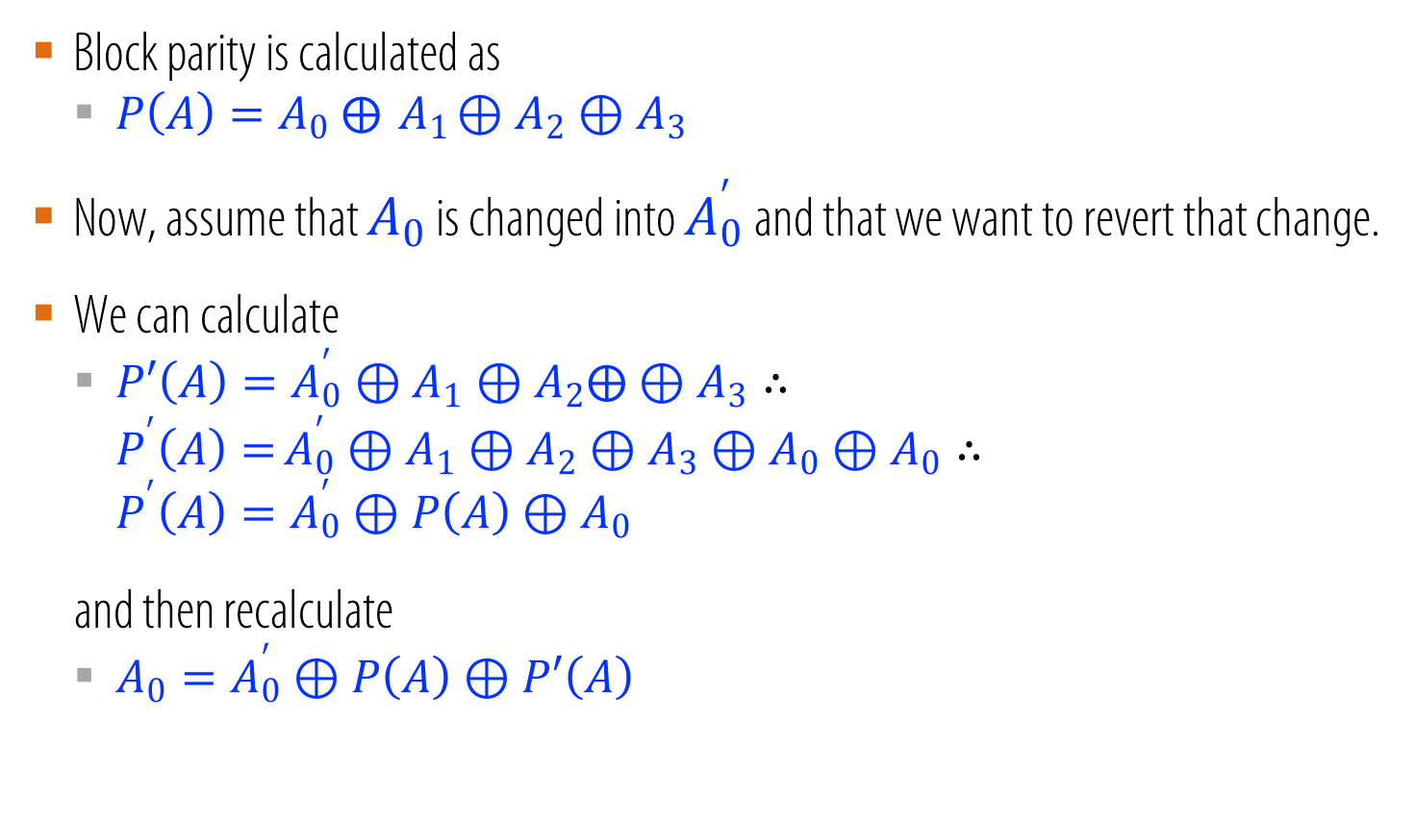
RAID 4 (block-interleaved parity)
Block parity is calculated as
$P\left(A\right)=A_{0} ⨁{ A}_{1}⊕A_{2}⊕A_{3}$
Now, assume that $A_{0}$ is changed into $A_{0}^{′}$ and that we want to revert that change.
We can calculate
$P′\left(A\right)=A_{0}^{′}⊕A_{1}⊕A_{2}⨁⊕A_{3}∴$
$P^{′}\left(A\right)=$ $A_{0}^{′}⊕A_{1}⊕A_{2}⊕A_{3}⊕A_{0}⊕A_{0}∴$
$$P^{′}\left(A\right)=A_{0}^{′}⊕P\left(A\right)⊕A_{0}$$
and then recalculate
$A_{0}=A_{0}^{′}⊕P\left(A\right)⊕P′\left(A\right)$

Slide 21
RAID 4 (block-interleaved parity)
Characteristics & Advantages
Disadvantages
Very high read data transaction rate
Low ratio of ECC (Parity) disks to data disks means high efficiency
High aggregate read transfer rate
Quite complex controller design
Worst write transaction rate and write aggregate transfer rate
Difficult and inefficient data rebuild in the event of disk failure
Block read transfer rate equal to that of a single disk

Slide 22
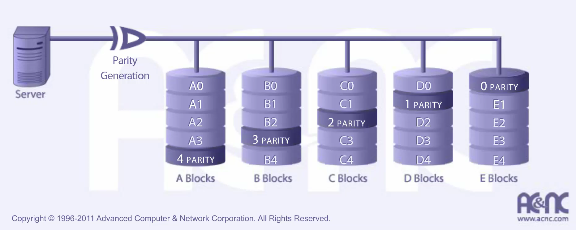
RAID 5 (block-interleaved distributed parity)
Each entire data block is written on a data disk.
Parity for blocks in the same rank is generated on Writes, recorded in a distributed location and checked on Reads.
RAID Level 5 requires a minimum of 3 drives to implement

Slide 23
RAID 5 (block-interleaved distributed parity)
Characteristics & Advantages
Disadvantages
Highest Read data transaction rate
Medium Write data transaction rate
Low ratio of ECC (Parity) disks to data disks means high efficiency
Good aggregate transfer rate
Disk failure has a medium impact on throughput
Most complex controller design
Difficult to rebuild in the event of a disk failure (as compared to RAID level 1)
Individual block data transfer rate same as single disk

Slide 24
RAID 6 (dual redundancy)
RAID 6 is essentially an extension of RAID level 5 which allows for additional fault tolerance by using a second independent distributed parity scheme (dual parity)
Data is striped on a block level across a set of drives, just like in RAID 5, and a second set of parity is calculated by a different algorithm and written across all the drives
RAID Level 6 requires a minimum of 4 drives to implement

Slide 25
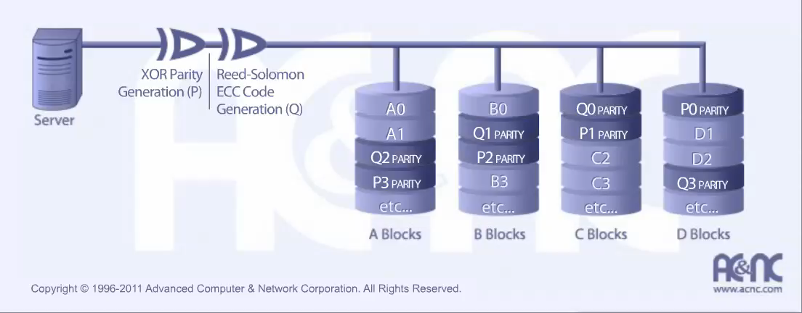
RAID 6 (dual redundancy)

Slide 26
RAID 6 (dual redundancy)
Characteristics & Advantages
Disadvantages
RAID 6 provides for an extremely high data fault tolerance and can sustain multiple simultaneous drive failures
RAID 6 protects against multiple bad block failures while non-degraded (all disks ok)
RAID 6 protects against a single bad block failure while operating in degraded mode (one faulty disk)
Perfect solution for mission critical applications
More complex controller design
Controller overhead to compute parity addresses is extremely high
Write performance can be brought on par with RAID Level 5 by using a custom ASIC for computing Reed-Solomon parity
Requires N+2 drives to implement because of dual parity scheme

Slide 27
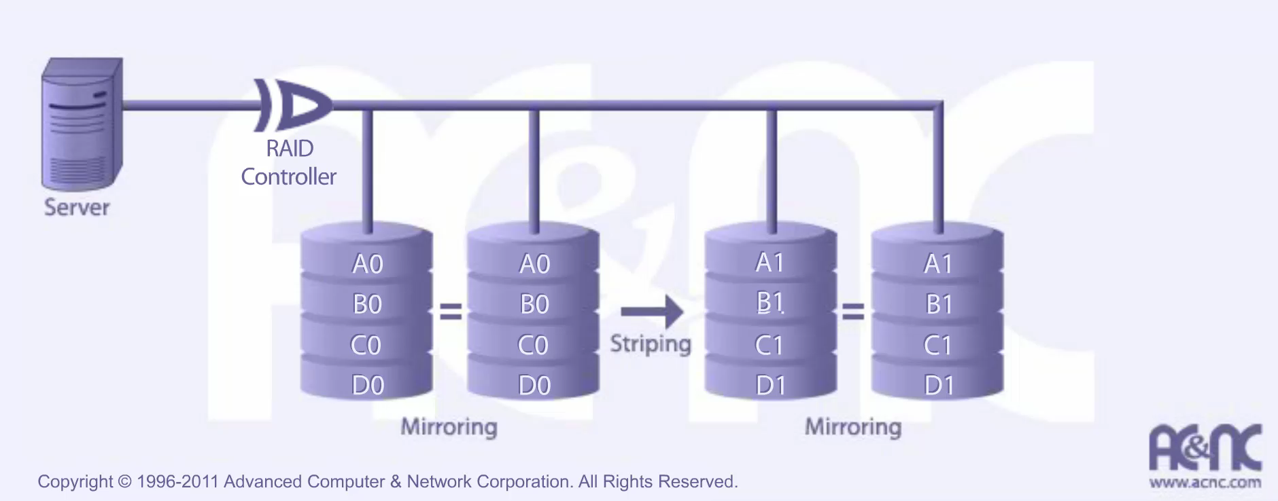
RAID 10 High Reliability and Performance
RAID 10 is implemented as a striped array of RAID 1 arrays
RAID Level 10 requires a minimum of 4 drives

Slide 28
RAID 10 (dual redundancy)
Characteristics & Advantages
Disadvantages
RAID 10 has the same fault tolerance as RAID level 1
RAID 10 has the same overhead for fault-tolerance as mirroring alone
High I/O rates are achieved by striping RAID 1 segments
Under certain circumstances. RAID 10 array can sustain multiple simultaneous drive failures
Excellent solution for sites that would have otherwise gone with RAID 1 but need some additional performance boost
Very expensive / High overhead
All drives must move in parallel to proper track lowering sustained performance
Very limited scalability at a very high inherent cost

Slide 29
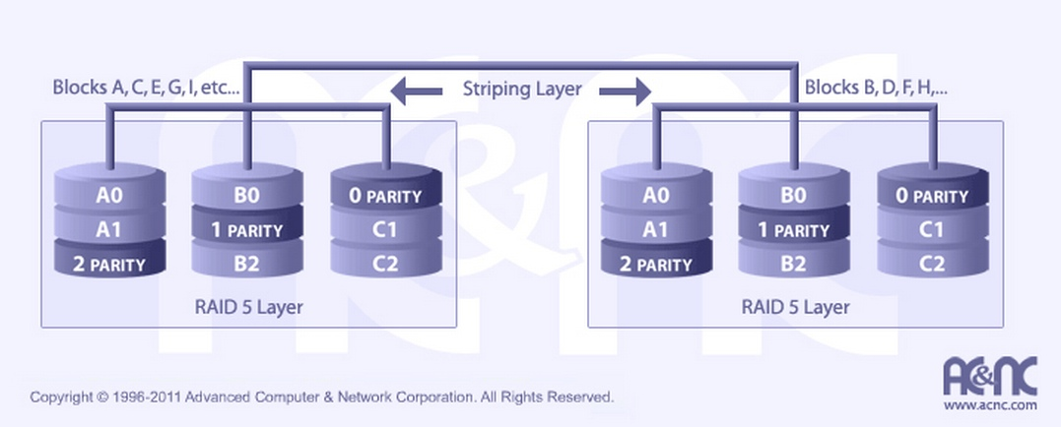
RAID 50 High I/O and Data Transfer Rates
RAID 50 should have been called “RAID 03” because it was implemented as a striped (RAID level 0) array whose segments were RAID 3 arrays (during mid-90s)
RAID Level 50 requires a minimum of 6 drives to implement

Slide 30
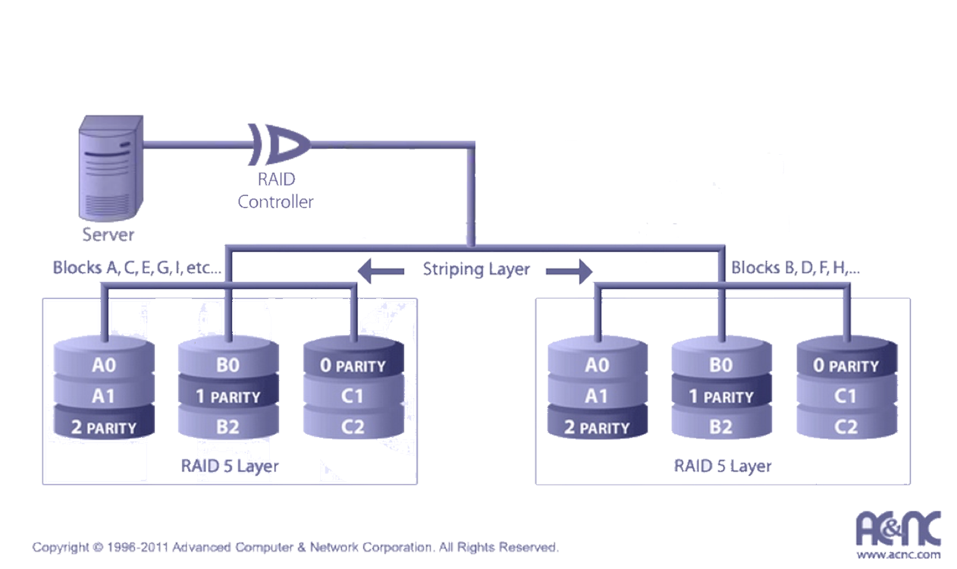
RAID 50 High I/O and Data Transfer Rates
RAID 50 should have been called “RAID 03” because it was implemented as a striped (RAID level 0) array whose segments were RAID 3 arrays (during mid-90s)
RAID Level 50 requires a minimum of 6 drives to implement

Slide 31
RAID 50 (high I/O and data transfer rates)
Characteristics & Advantages
Disadvantages
RAID 50 is more fault tolerant than RAID 5 but has twice the parity overhead
High data transfer rates are achieved thanks to its RAID 5 array segments
High I/O rates for small requests are achieved thanks to its RAID 0 striping
Maybe a good solution for sites who would have otherwise gone with RAID 5 but need some additional performance boost
Very expensive to implement
All disk spindles must be synchronized, which limits the choice of drives
Failure of two drives in one of the RAID 5 segments renders the whole array unusable

Slide 32
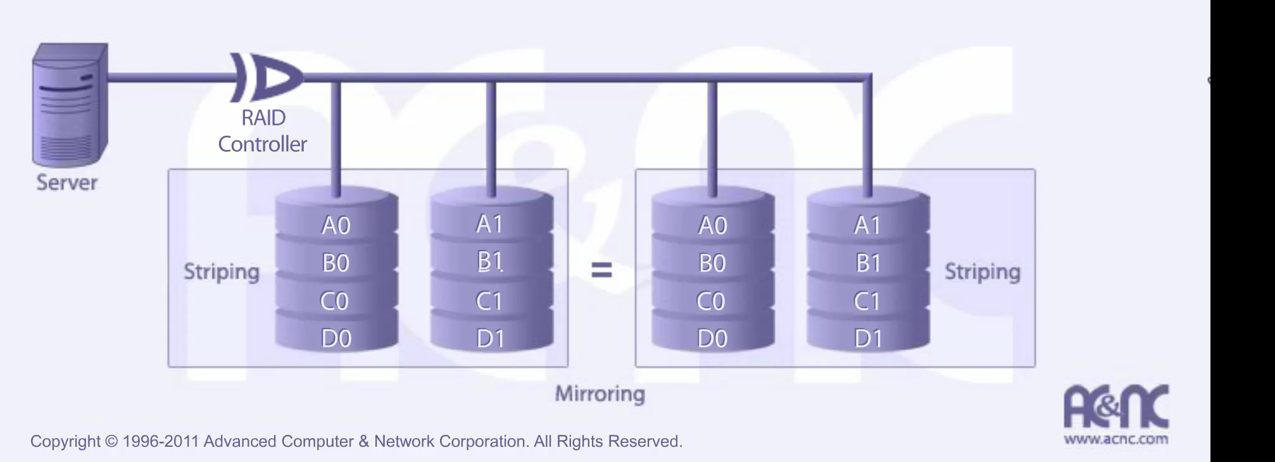
RAID 0+1 (high data transfer performance)
RAID 0+1 is implemented as a mirrored array whose segments are RAID 0 arrays
RAID Level 0+1 requires a minimum of 4 drives to implement

Slide 33
RAID 0+1 (high data transfer performance)
Characteristics & Advantages
Disadvantages
RAID 0+1 has the same fault tolerance as RAID level 5
RAID 0+1 has the same overhead for fault-tolerance as mirroring alone
High I/O rates are achieved thanks to multiple stripe segments
Excellent solution for sites that need high performance but are not concerned with achieving maximum reliability
RAID 0+1 is NOT to be confused with RAID 10.
A single drive failure will cause the whole array to become, in essence, a RAID Level 0 array
Very expensive / High overhead
All drives must move in parallel to proper track lowering sustained performance
Very limited scalability at a very high inherent cost

Slide 34
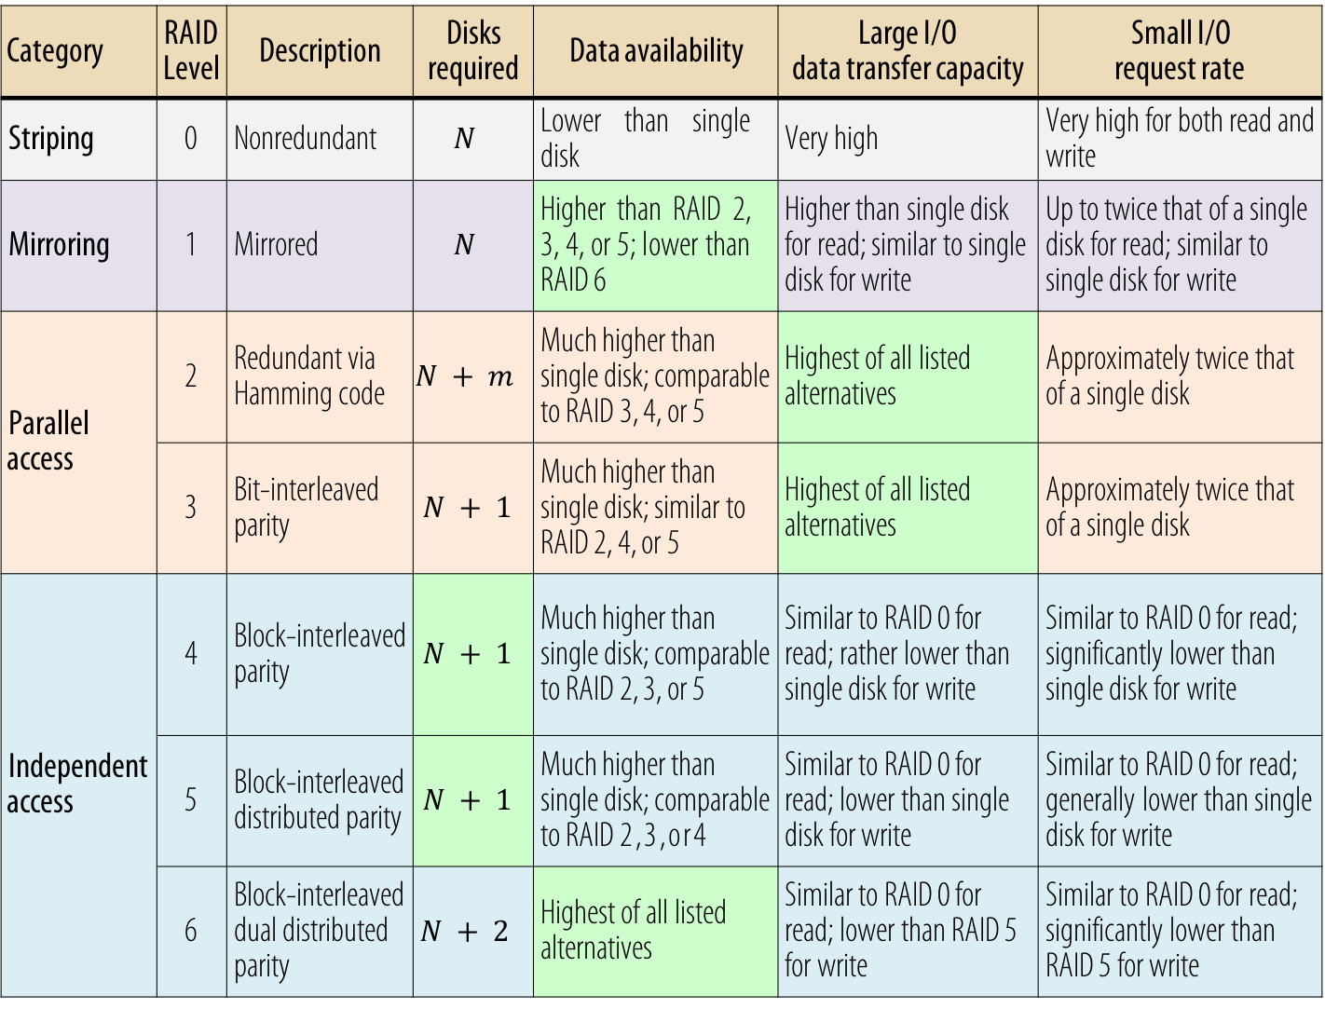
Category | RAIDLevel | Description | Disks required | Data availability | Large I/O data transfer capacity | Small I/O request rate
Striping | 0 | Nonredundant | $$N$$ | Lower than single disk | Very high | Very high for both read and write
Mirroring | 1 | Mirrored | $$N$$ | Higher than RAID 2, 3, 4, or 5; lower than RAID 6 | Higher than single disk for read; similar to single disk for write | Up to twice that of a single disk for read; similar to single disk for write
Parallel access | 2 | Redundant via Hamming code | $$N+m$$ | Much higher than single disk; comparable to RAID 3, 4, or 5 | Highest of all listed alternatives | Approximately twice that of a single disk
 | 3 | Bit-interleaved parity | $$N+1$$ | Much higher than single disk; similar to RAID 2, 4, or 5 | Highest of all listed alternatives | Approximately twice that of a single disk
Independent access | 4 | Block-interleaved parity | $$N+1$$ | Much higher than single disk; comparable to RAID 2, 3, or 5 | Similar to RAID 0 for read; rather lower than single disk for write | Similar to RAID 0 for read; significantly lower than single disk for write
 | 5 | Block-interleaved distributed parity | $$N+1$$ | Much higher than single disk; comparable to RAID 2,3,or4 | Similar to RAID 0 for read; lower than single disk for write | Similar to RAID 0 for read; generally lower than single disk for write
 | 6 | Block-interleaved dual distributed parity | $$N+2$$ | Highest of all listed alternatives | Similar to RAID 0 for read; lower than RAID 5 for write | Similar to RAID 0 for read; significantly lower than RAID 5 for write

Slide 35
Hamming Code

Slide 36
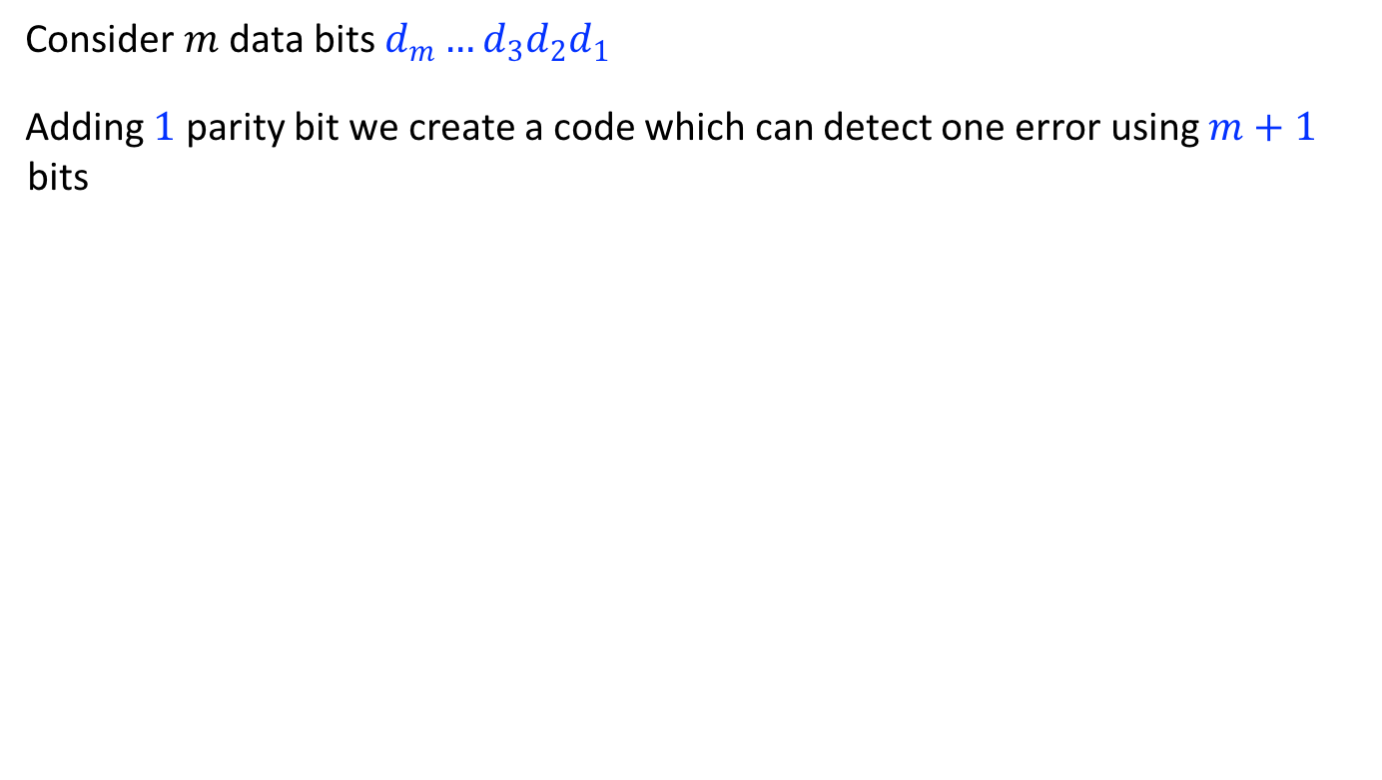
Hamming code for detecting and correcting a single error
Consider $m$ data bits $d_{m}…d_{3}d_{2}d_{1}$
Adding $1$ parity bit we create a code which can detect one error using $m+1$ bits

Slide 37
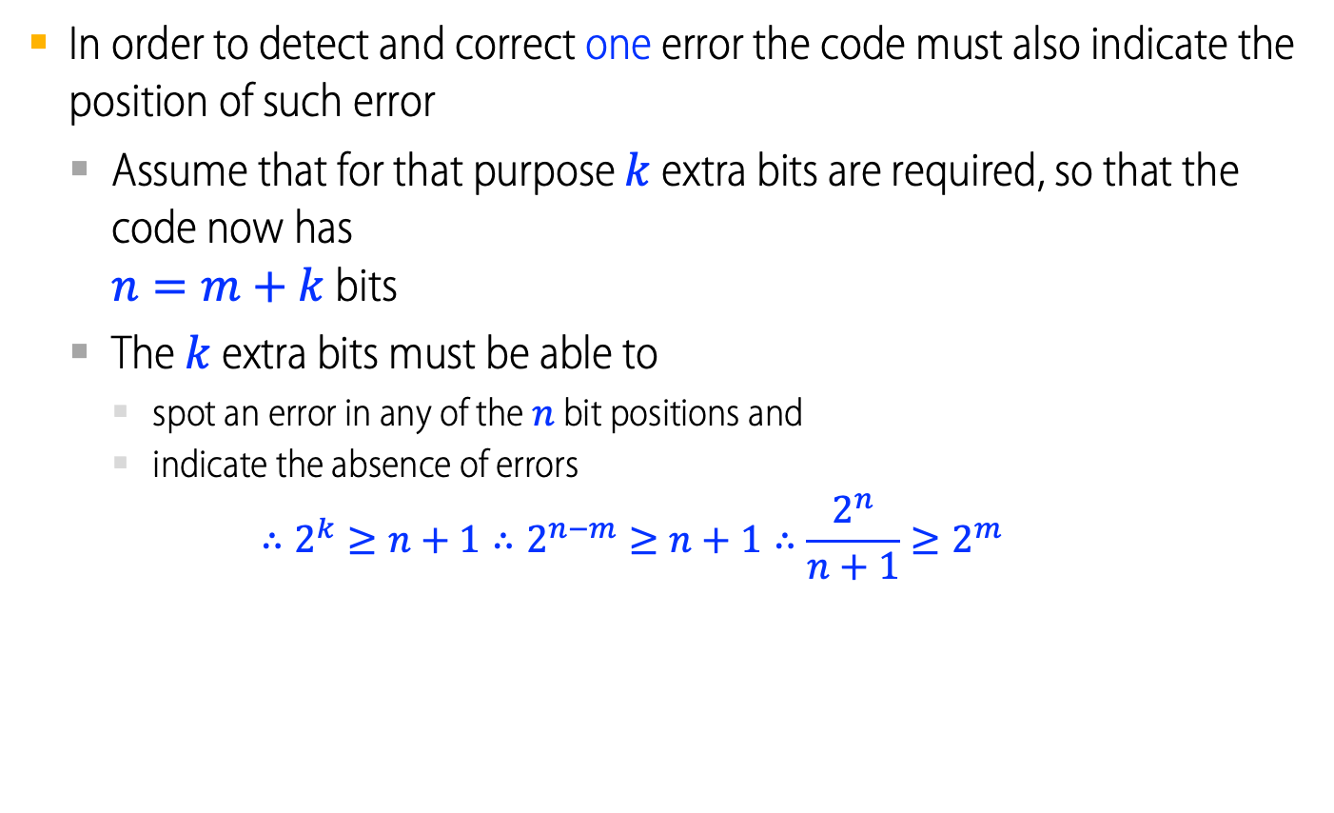
Hamming code for detecting and correcting a single error
In order to detect and correct one error the code must also indicate the position of such error
Assume that for that purpose $k$ extra bits are required, so that the code now has $n=m+k$ bits
The $k$ extra bits must be able to
spot an error in any of the $n$ bit positions and
indicate the absence of errors $∴2^{k}≥n+1∴2^{n−m}≥n+1∴\frac{2^{n}}{n+1}≥2^{m}$
$$∴2^{k}≥n+1∴2^{n−m}≥n+1∴\frac{2^{n}}{n+1}≥2^{m}$$

Slide 38
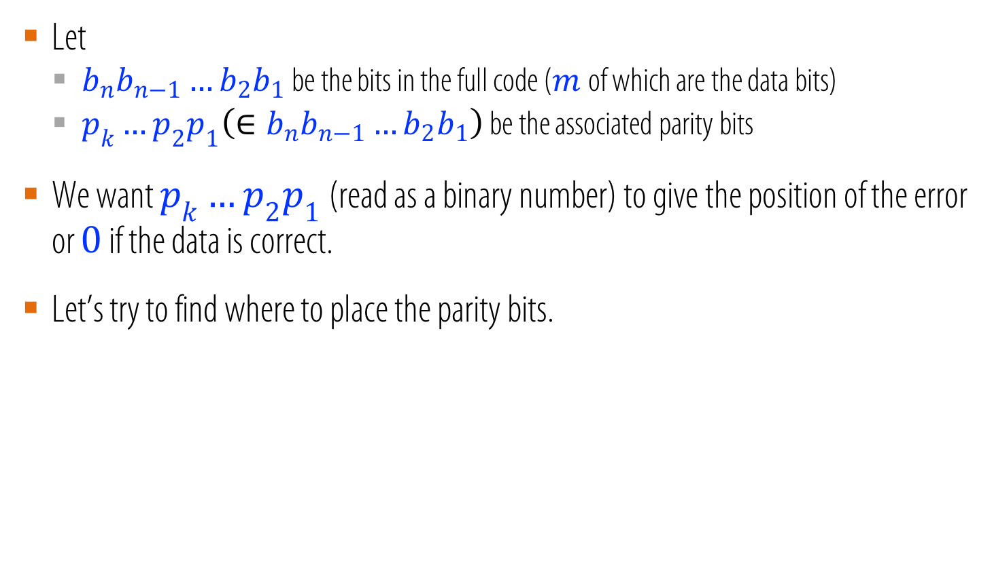
Hamming code for detecting and correcting a single error
Let
$b_{n}b_{n−1}…b_{2}b_{1}$ be the bits in the full code ($m$of which are the data bits)
$p_{k}…p_{2}p_{1}\left(∈b_{n}b_{n−1}…b_{2}b_{1}\right)$ be the associated parity bits
We want $p_{k}…p_{2}p_{1}$ (read as a binary number) to give the position of the error or $0$ if the data is correct.
Let’s try to find where to place the parity bits.

Slide 39

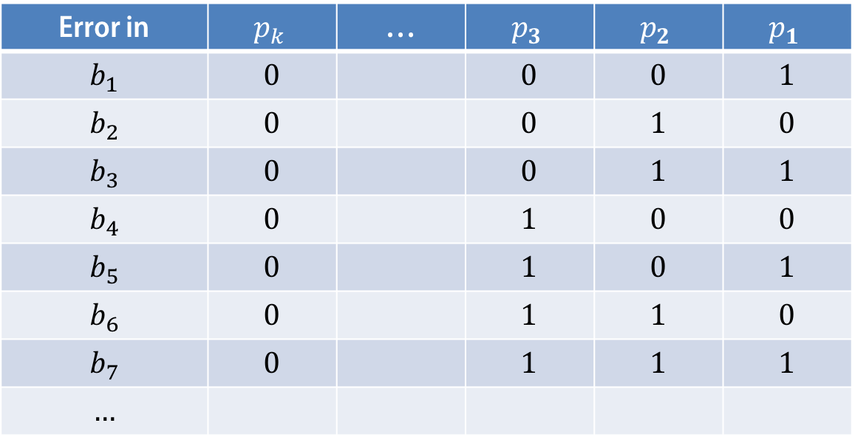
Hamming code for detecting and correcting a single error
We want $p_{k}…p_{2}p_{1}$ (read as a binary number) to give the position of the error or $0$ if the data is correct.
Error in | $$p_{k}$$ | … | $$p_{3}$$ | $$p_{2}$$ | $$p_{1}$$
$$b_{1}$$ | $$0$$ |  | $$0$$ | $$0$$ | $$1$$
$$b_{2}$$ | $$0$$ |  | $$0$$ | $$1$$ | $$0$$
$$b_{3}$$ | $$0$$ |  | $$0$$ | $$1$$ | $$1$$
$$b_{4}$$ | $$0$$ |  | $$1$$ | $$0$$ | $$0$$
$$b_{5}$$ | $$0$$ |  | $$1$$ | $$0$$ | $$1$$
$$b_{6}$$ | $$0$$ |  | $$1$$ | $$1$$ | $$0$$
$$b_{7}$$ | $$0$$ |  | $$1$$ | $$1$$ | $$1$$
$$…$$

Slide 40
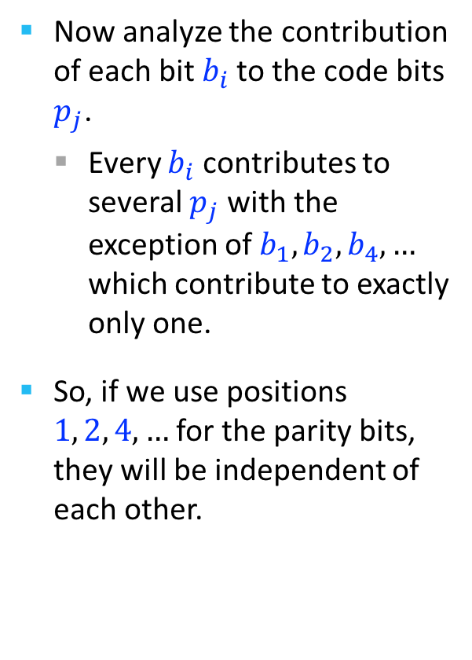
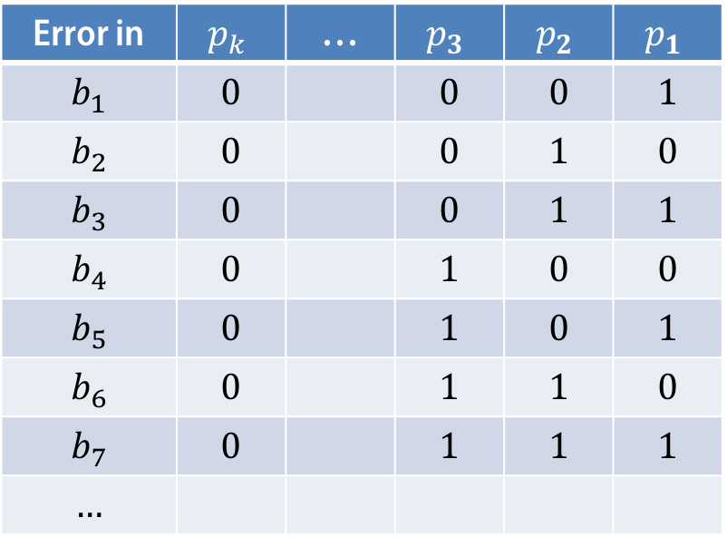
Hamming code for detecting and correcting a single error
Now analyze the contribution of each bit $b_{i}$ to the code bits $p_{j}$.
Every $b_{i}$ contributes to several $p_{j}$ with the exception of $b_{1},b_{2},b_{4},…$ which contribute to exactly only one.
So, if we use positions $1, 2, 4, …$ for the parity bits, they will be independent of each other.
Error in | $$p_{k}$$ | … | $$p_{3}$$ | $$p_{2}$$ | $$p_{1}$$
$$b_{1}$$ | $$0$$ |  | $$0$$ | $$0$$ | $$1$$
$$b_{2}$$ | $$0$$ |  | $$0$$ | $$1$$ | $$0$$
$$b_{3}$$ | $$0$$ |  | $$0$$ | $$1$$ | $$1$$
$$b_{4}$$ | $$0$$ |  | $$1$$ | $$0$$ | $$0$$
$$b_{5}$$ | $$0$$ |  | $$1$$ | $$0$$ | $$1$$
$$b_{6}$$ | $$0$$ |  | $$1$$ | $$1$$ | $$0$$
$$b_{7}$$ | $$0$$ |  | $$1$$ | $$1$$ | $$1$$
$$…$$
●

Slide 41
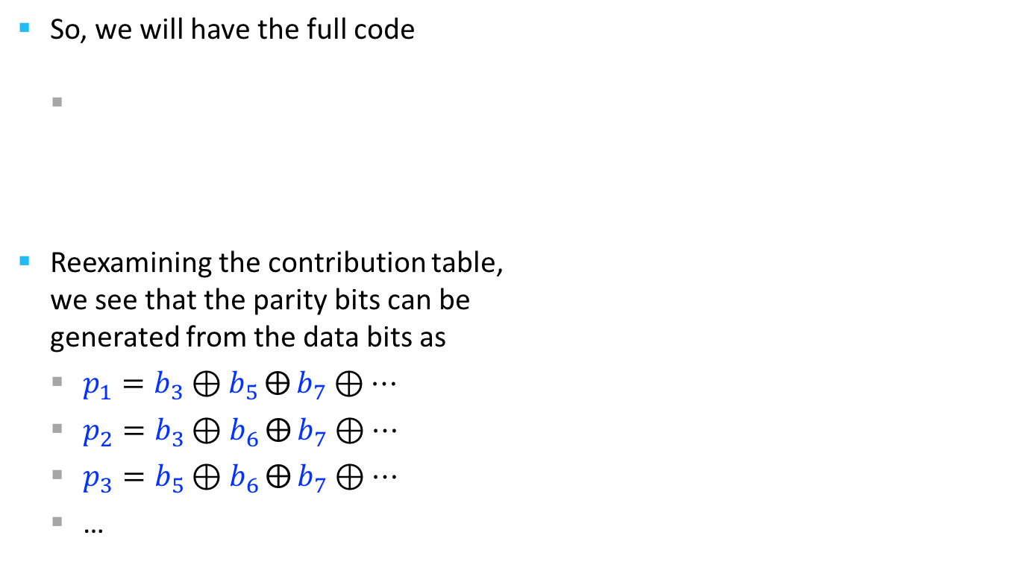
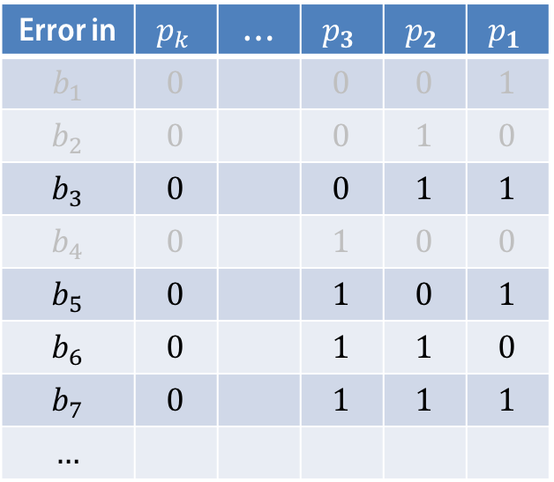
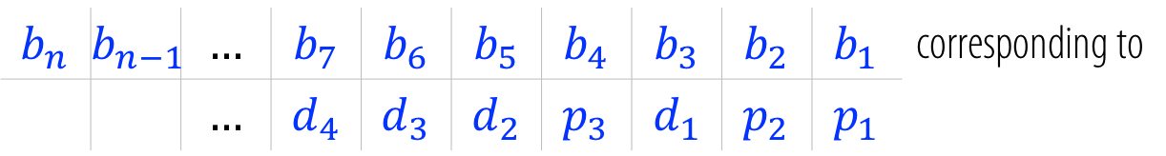
Hamming code for detecting and correcting a single error
So, we will have the full code
Reexamining the contribution table, we see that the parity bits can be generated from the data bits as
$p_{1}=b_{3}⊕b_{5}⨁{b_{7}}⊕…$
$p_{2}=b_{3}⊕b_{6}⨁{b_{7}}⊕…$
$p_{3}=b_{5}⊕b_{6}⨁{b_{7}}⊕…$
…
$$b_{n}$$ | $$b_{n−1}$$ | $$…$$ | $$b_{7}$$ | $$b_{6}$$ | $$b_{5}$$ | $$b_{4}$$ | $$b_{3}$$ | $$b_{2}$$ | $$b_{1}$$ | corresponding to
 |  | $$…$$ | $$d_{4}$$ | $$d_{3}$$ | $$d_{2}$$ | $$p_{3}$$ | $$d_{1}$$ | $$p_{2}$$ | $$p_{1}$$
Error in | $$p_{k}$$ | … | $$p_{3}$$ | $$p_{2}$$ | $$p_{1}$$
$$b_{1}$$ | $$0$$ |  | $$0$$ | $$0$$ | $$1$$
$$b_{2}$$ | $$0$$ |  | $$0$$ | $$1$$ | $$0$$
$$b_{3}$$ | $$0$$ |  | $$0$$ | $$1$$ | $$1$$
$$b_{4}$$ | $$0$$ |  | $$1$$ | $$0$$ | $$0$$
$$b_{5}$$ | $$0$$ |  | $$1$$ | $$0$$ | $$1$$
$$b_{6}$$ | $$0$$ |  | $$1$$ | $$1$$ | $$0$$
$$b_{7}$$ | $$0$$ |  | $$1$$ | $$1$$ | $$1$$
$$…$$

Slide 42
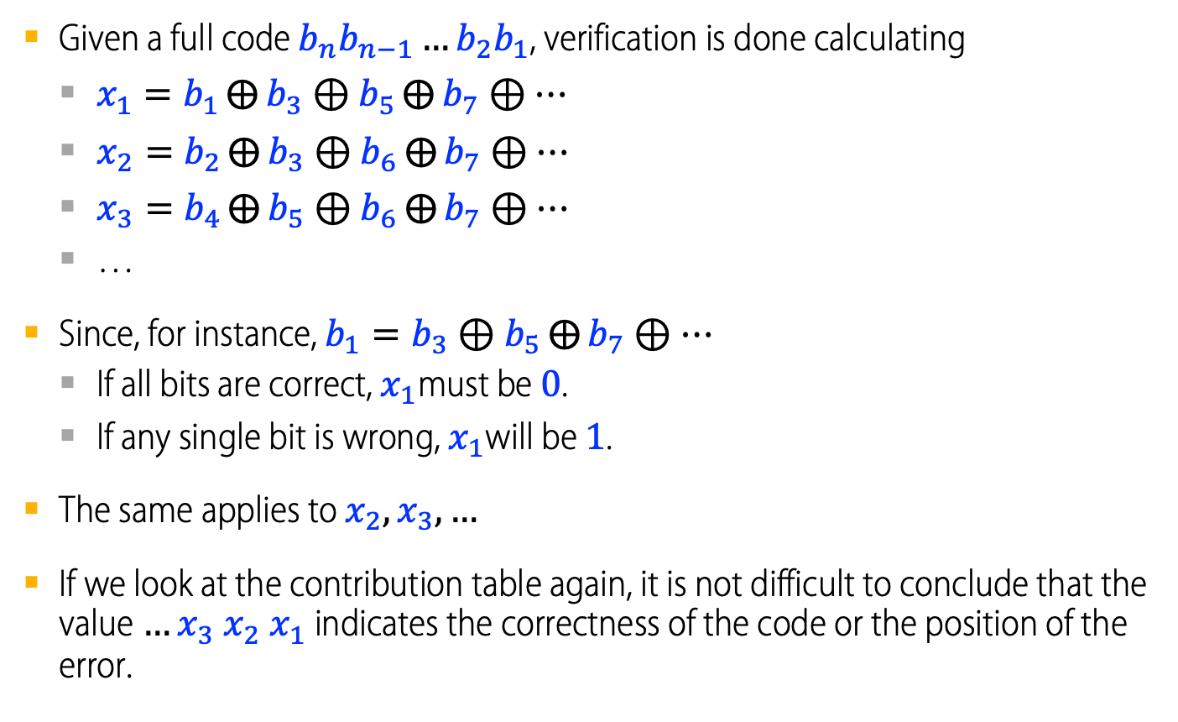
Hamming code for detecting and correcting a single error
Given a full code $b_{n}b_{n−1}…b_{2}b_{1}$, verification is done calculating
$x_{1}=b_{1}⨁{b_{3}}⊕b_{5}⨁{b_{7}}⊕…$
$x_{2}=b_{2}⨁{b_{3}}⊕b_{6}⨁{b_{7}}⊕…$
$x_{3}=b_{4}⨁{b_{5}}⊕b_{6}⨁{b_{7}}⊕…$
…
Since, for instance, $b_{1}=b_{3}⊕b_{5}⨁{b_{7}}⊕…$
If all bits are correct, $x_{1}$must be $0$.
If any single bit is wrong, $x_{1}$will be $1$.
The same applies to $x_{2},x_{3},…$
If we look at the contribution table again, it is not difficult to conclude that the value $…x_{3} x_{2} x_{1}$ indicates the correctness of the code or the position of the error.

Slide 43
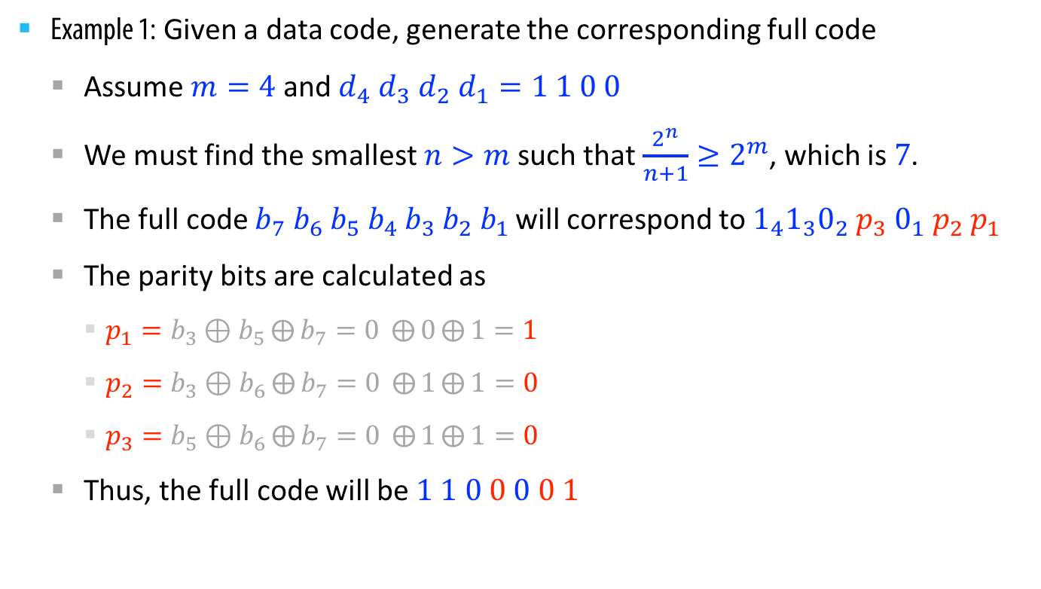
Hamming code for detecting and correcting a single error
Example 1: Given a data code, generate the corresponding full code
Assume $m=4$ and $d_{4} d_{3} d_{2} d_{1}=1 1 0 0$
We must find the smallest $n>m$ such that $\frac{2^{n}}{n+1}≥2^{m}$, which is $7$.
The full code $b_{7}{ b}_{6} b_{5} b_{4} b_{3}{ b}_{2}{ b}_{1}$ will correspond to $1_{4}1_{3}0_{2}{ p}_{3} 0_{1} p_{2} p_{1}$
The parity bits are calculated as
$p_{1}=b_{3}⊕b_{5}⨁{b_{7}}=0 ⨁{0}⨁{1}=1$
$p_{2}=b_{3}⊕b_{6}⨁{b_{7}}=0 ⨁{1}⨁{1}=0$
$p_{3}=b_{5}⊕b_{6}⨁{b_{7}}=0 ⨁{1}⨁{1}=0$
Thus, the full code will be $1 1 0 0 0 0 1$

Slide 44
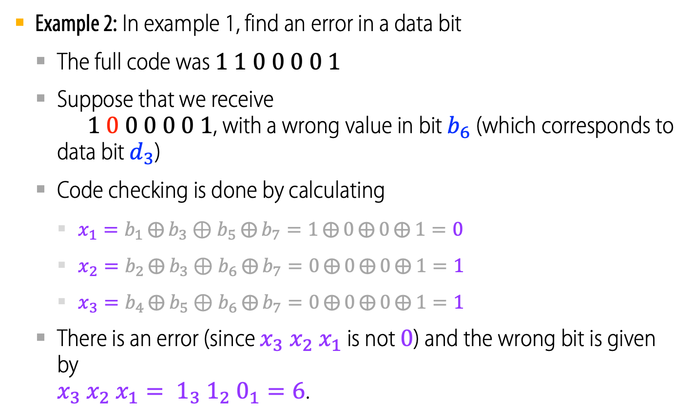
Hamming code for detecting and correcting a single error
Example 2: In example 1, find an error in a data bit
The full code was $1 1 0 0 0 0 1$
Suppose that we receive $1 0 0 0 0 0 1$, with a wrong value in bit $b_{6}$ (which corresponds to data bit $d_{3}$)
Code checking is done by calculating
$x_{1}=b_{1}⨁{b_{3}}⊕b_{5}⨁{b_{7}}=1⨁{0}⨁{0}⨁{1}=0$
$x_{2}=b_{2}⨁{b_{3}}⊕b_{6}⨁{b_{7}}=0⨁{0}⨁{0}⨁{1}=1$
$x_{3}=b_{4}⨁{b_{5}}⊕b_{6}⨁{b_{7}}=0⨁{0}⨁{0}⨁{1}=1$
There is an error (since $x_{3} x_{2} x_{1}$ is not $0$) and the wrong bit is given by $x_{3} x_{2} x_{1}= 1_{3} 1_{2} 0_{1}=6$.
●

Slide 45
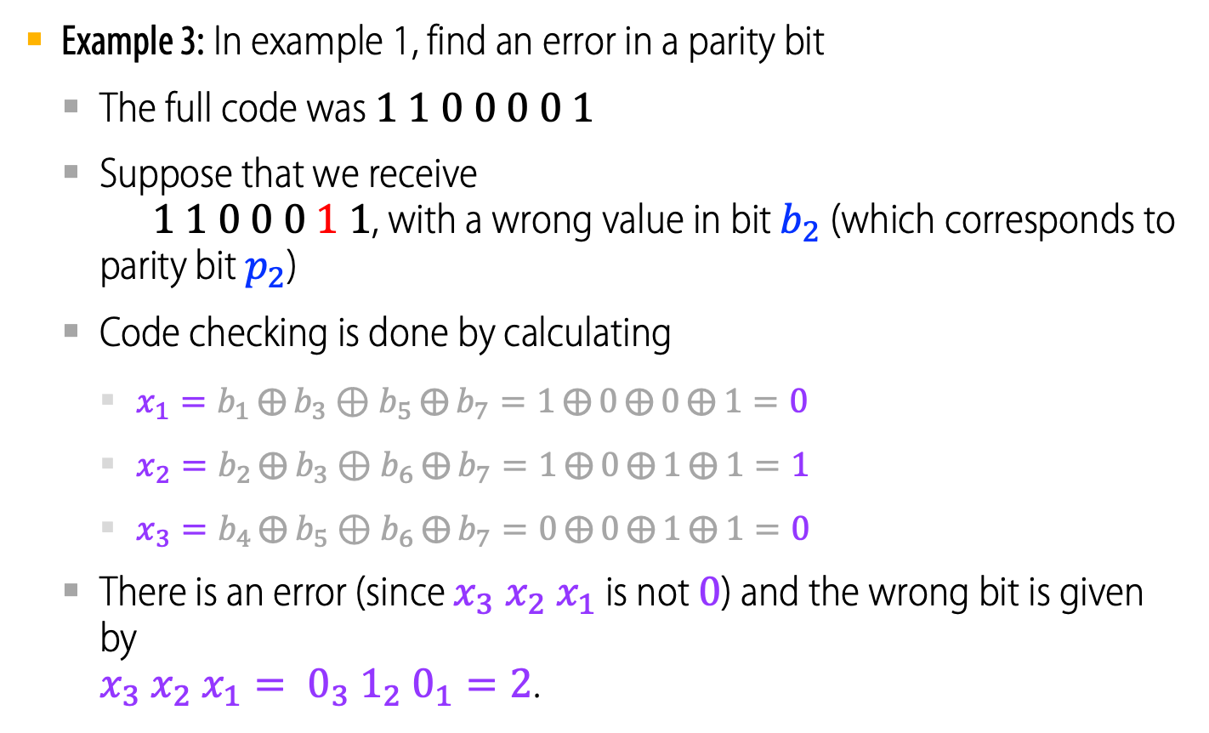
Hamming code for detecting and correcting a single error
Example 3: In example 1, find an error in a parity bit
The full code was $1 1 0 0 0 0 1$
Suppose that we receive $1 1 0 0 0 1 1$, with a wrong value in bit $b_{2}$ (which corresponds to parity bit $p_{2}$)
Code checking is done by calculating
$x_{1}=b_{1}⨁{b_{3}}⊕b_{5}⨁{b_{7}}=1⨁{0}⨁{0}⨁{1}=0$
$x_{2}=b_{2}⨁{b_{3}}⊕b_{6}⨁{b_{7}}=1⨁{0}⨁{1}⨁{1}=1$
$x_{3}=b_{4}⨁{b_{5}}⊕b_{6}⨁{b_{7}}=0⨁{0}⨁{1}⨁{1}=0$
There is an error (since $x_{3} x_{2} x_{1}$ is not $0$) and the wrong bit is given by $x_{3} x_{2} x_{1}= 0_{3} 1_{2} 0_{1}=2$.
●

